Slide 1
1 St Session Submission
Bhavik Modi
Bmodi700@gmail.com
9727287923

Slide 2
Problem Statement: Predict whether income exceeds $50K/yr based on census data.
Steps Taken for Solution :
1. Perform EDA
* EDA.html
Prepared HTML interactive Charts for all possible analysis
* Prepared PDF file for charts
2. Prepare Model
* Used Auto Sklearn and Trained it for 10 mint

Slide 3
Result :
Probability of earning >50 K if following status :
Husband
Residing in US (90 % of people
Married-Cil-Spouse
White race
Prof-Speciality and Craft Repair occupation
Male
Fed-Gov. employee
Refer attached HTML File for more details

Slide 4
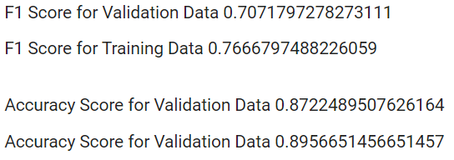
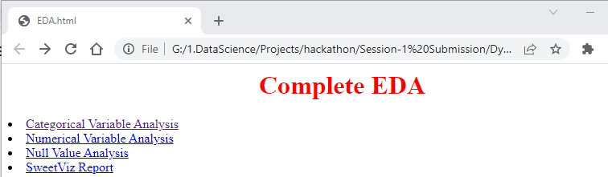
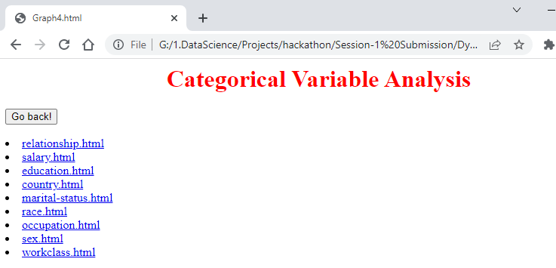
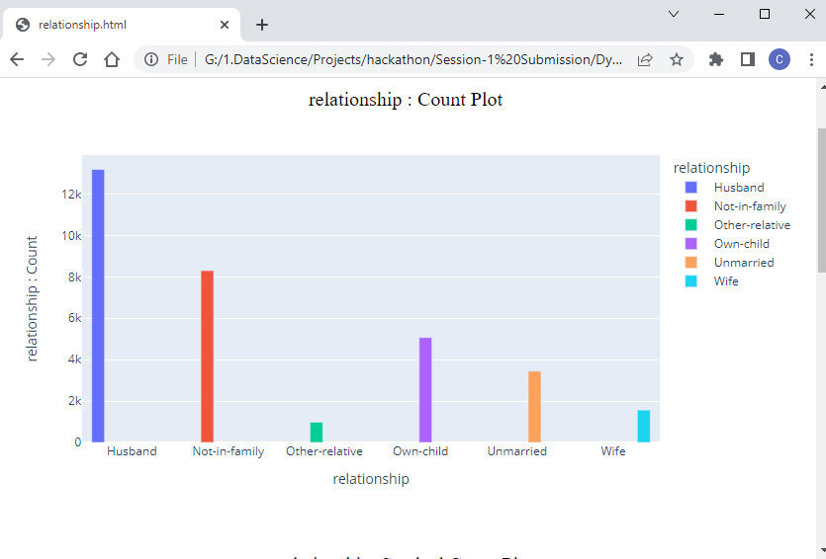
Glimpse :
Interactive Chart for all feature :

